Slide 1
Freshmen Advising Workshop: Preparing for Spring 2020 Registration
October 2019

Slide 2
Questions
What is the Center for Student Success?
What are the requirements of a Bachelor's Degree?
What is General Education?
What are my Major requirements?
What is an Elective? How many do I need?
Is there a place to see all of my Requirements?
How do I create a Schedule?
What happens during my Registration Appointment?

Slide 3
What is the Center for Student Success?
Student Success Advisors
Assist you in making decisions
Answer questions
Help you sort out your options
Inform you
Listen
Will not tell you what to do, but will help you understand the options

Slide 4
What are the Requirements of a Bachelor’s Degree?
General Education Requirements
(approx. 30 credits)
+
Major Requirements
(40-90+ credits)
+
Electives
(0-?? credits)
__________________________________________
120 credits

Slide 5
What is general education?

Slide 6
What is General Education?
Classes all students take to meet the requirements of an education at Aurora University
Complement or supplement your major
Help make you a well-rounded student and citizen

Slide 7
Overall Requirements
Requirement | Credits | Year Completed
IDS1150: First Year Experience | 1 credit | Freshman
IDS1200: Discover What Matters | 4 credits | Freshman
ENG1000: Introduction to Academic Writing | 4 credits | Freshman
IDS3500/3550: Junior Mentoring | 1 credit | Junior
Math Course (MTH1030 or above) | 0-4 credits | Depends on requirements
Creative & Artistic Expression Course | 2.5-4 credits | Depends on requirements
Cultures & Civilizations Course | 2.5-4 credits | Depends on requirements
Individual & Society Course | 2.5-4 credits | Depends on requirements
Scientific Reasoning & Quantitative Analysis Course | 2.5-4 credits | Depends on requirements

Slide 8
Minimum Math Requirements
Course | Major
MTH1010: Foundations of Algebra and/or MTH1100: College Algebra | Accounting, Actuarial Science, Biology, Chemistry, Computer Science, Engineering Sciences, Exercise Science, Finance, Health Science, Human-Animal Studies, Mathematics, Nursing, Parks & Recreation Leadership, Psychology, Sociology, Software Engineering
MTH1030: Quantitative Reasoning | Business Administration, Communication, Criminal Justice, Disabilities Studies, English, Environmental Studies, Graphic Design, History, Marketing, Music, Musical Theatre, Physical Education, Political Science & Public Policy, Social Work, Spanish, Sport Management, Theatre, Therapeutic Recreation, Professional Writing
MTH1210: Math for Elementary Teachers I | Early Childhood Special Education, Elementary Education, Special Education

Slide 9
What are my major requirements?

Slide 10
Visit aurora.edu/academics/resources/academic-catalog.html to view the 2019-20 Undergraduate Catalog.

Slide 12
What is an elective?

Slide 13
What is an Elective?
Any course not required for general education or your major
Electives
are interesting
are courses in a subject in which you might want to add a major or minor
compliment your major and general education coursework

Slide 14
How Many Electives do I Need?
Credits required for your general education program
Credits required for your major
Subtract that number from 120

Slide 15
How Many Electives do I Need?
 | General Education | Major
 | ENG1000 (4) MTH1030 (4) IDS1150 (1) IDS1200 (4) IDS3500/3550 (1) Creative & Artistic Expression Course (4) Cultures & Civilizations Course (4) Scientific Reason. & Quant. Analysis Course (4) | ACC1010 (4) BUS1020(4) BUS1200(4) ECN2030-Individual & Society Course (4) MKT2300 (4) BUS3280 (4) BUS3560 (4) FIN3400 (4) Selected Major Course (4) Business Capstone Course (4)
Total credits | 26 | 40

Slide 16
How Many Electives do I Need?
General Education Requirements (approx. 30 credits) + Major Requirements (40-90+ credits) + Electives (0-?? credits) ______________________________ 120 credits | General Education Requirements 26 + Major Requirements 40 + Electives (26+40=66; 120-66=54) 54 ______________________________ 120 credits

Slide 17
Is there a place to see all of my requirements?

Slide 18
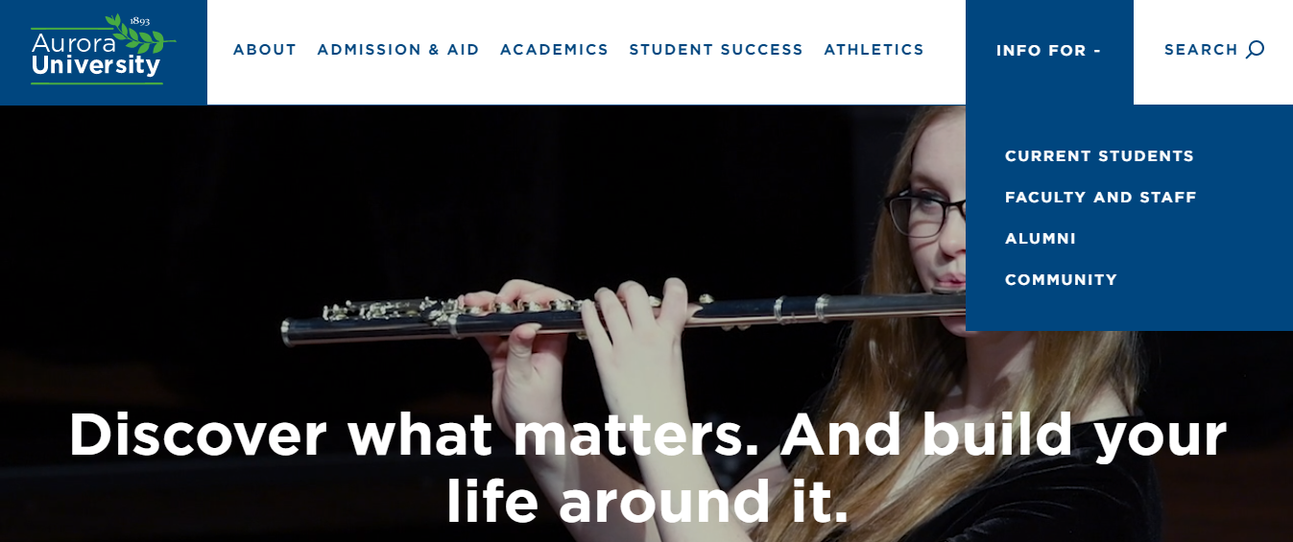
Click on INFO FOR and then CURRENT STUDENTS at the top of the homepage at www.aurora.edu.

Slide 19
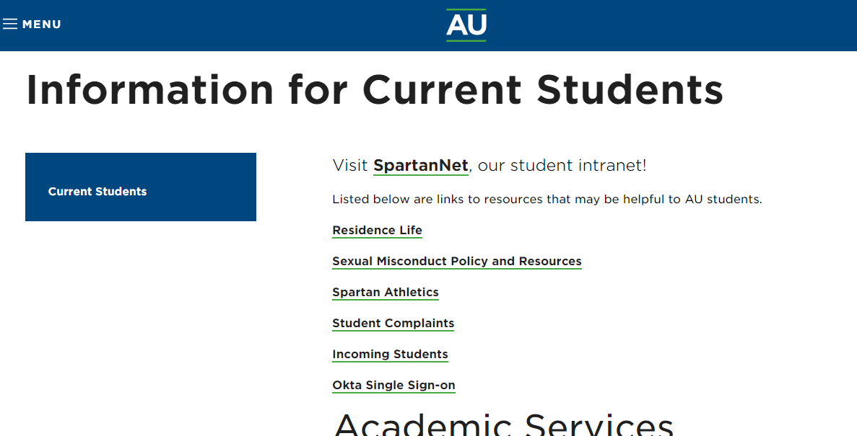
Click on Okta Single Sign-on.

Slide 20
Log In using your AU credentials.
If you need assistance logging in, contact the ITS Help Desk at 630-844-5790.

Slide 21
Click on the WebAdvisor app.

Slide 22
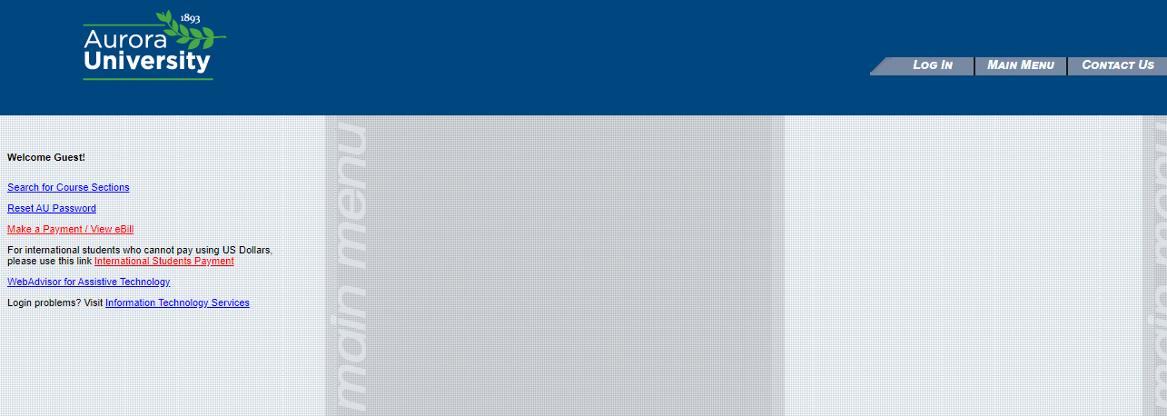
Click on Log In at the top of the screen.

Slide 23
After logging in, click on the Students menu.

Slide 24
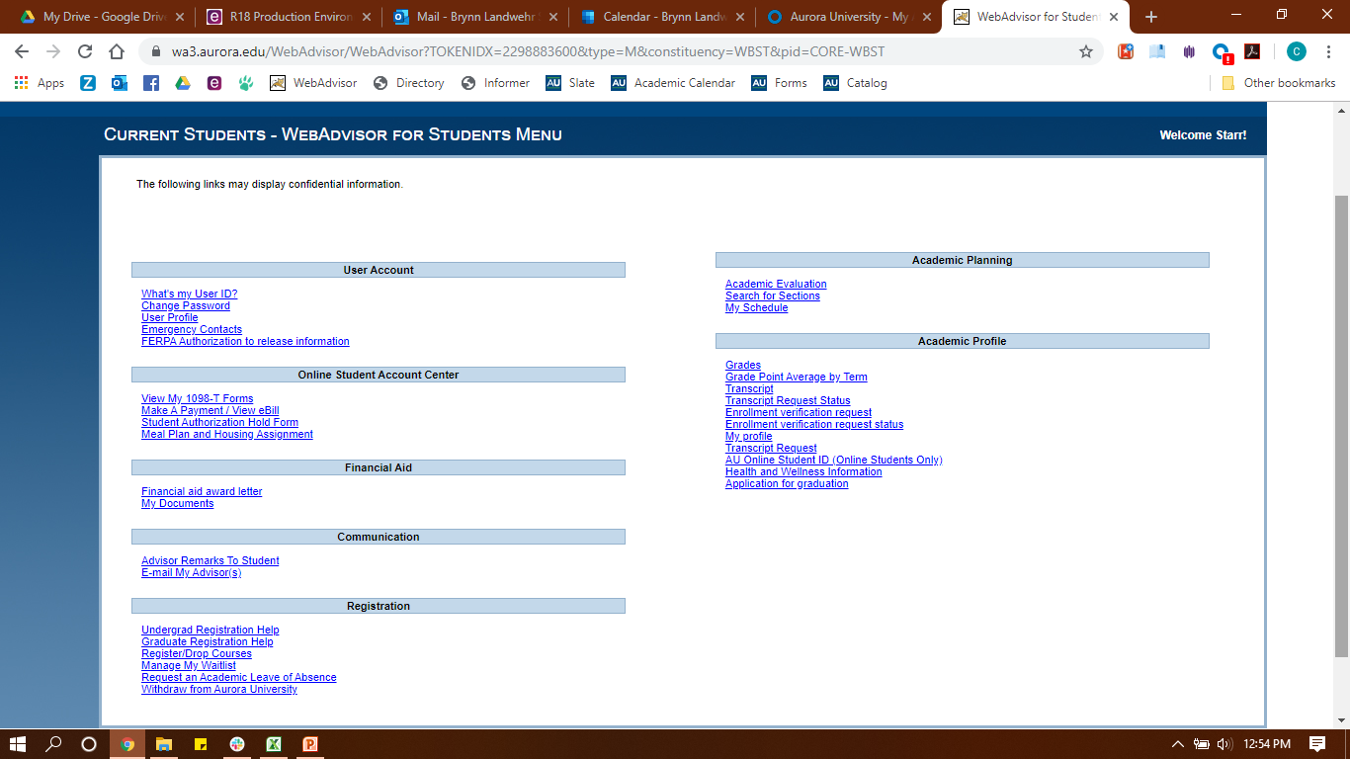
Click on Academic Evaluation.

Slide 25
Your major should be listed under Active Programs.
Choose your major and click Submit.

Slide 26
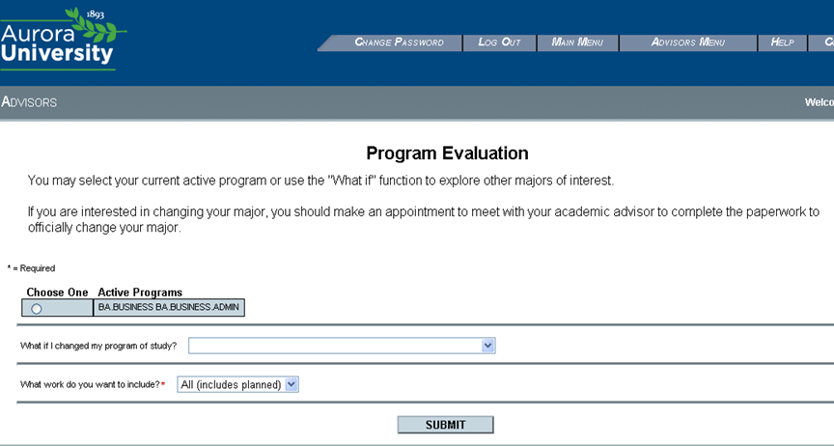
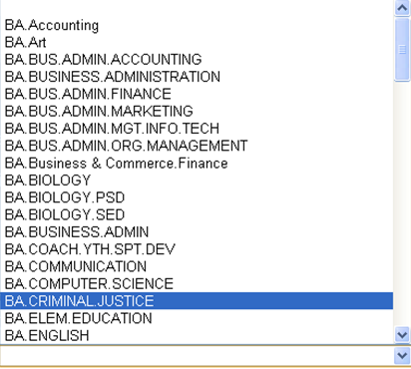
If you are thinking about changing your major, choose a new major from the “What if I changed my program of study?” drop-down menu to see an Academic Evaluation with those requirements.

Slide 27
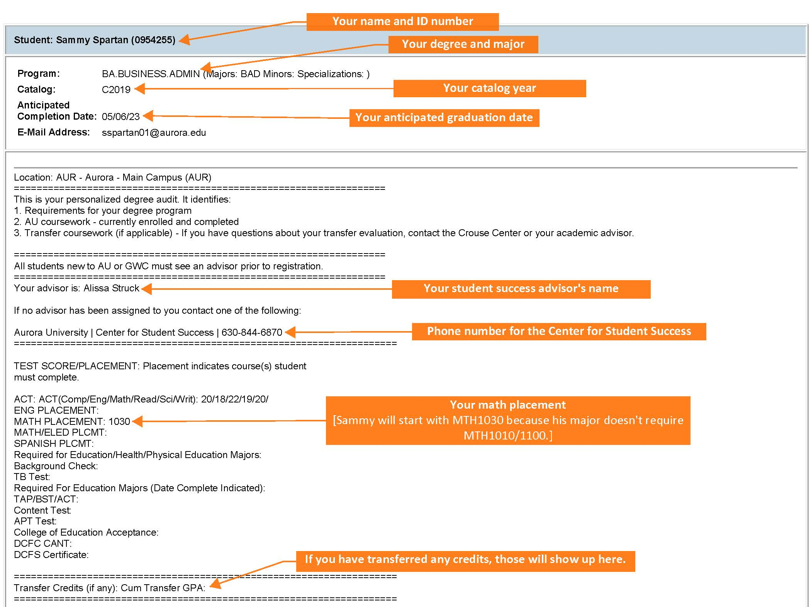
Your Academic Evaluation shows all of the requirements for your degree.

Slide 28
How do I Know if a Requirement is Complete?
(Not Started) | You haven’t started this requirement.
(In Progress) | You have started this requirement, but there is still more to be done.
(Pending completion of unfinished activity) | You are registered for the requirement(s) that will complete this category.
(Complete) | You have completed this requirement!

Slide 29
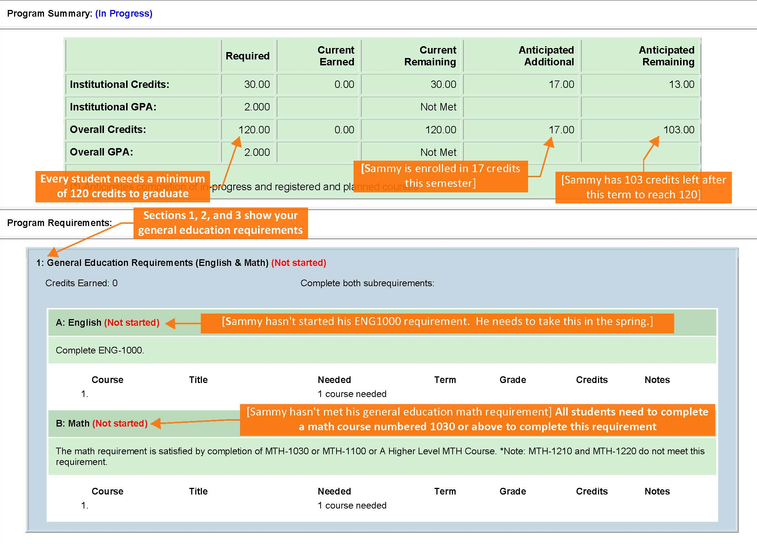

Slide 30
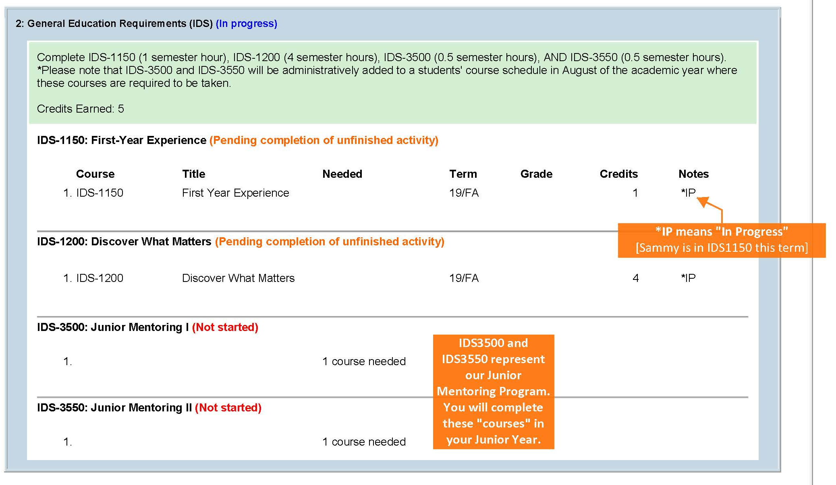

Slide 31
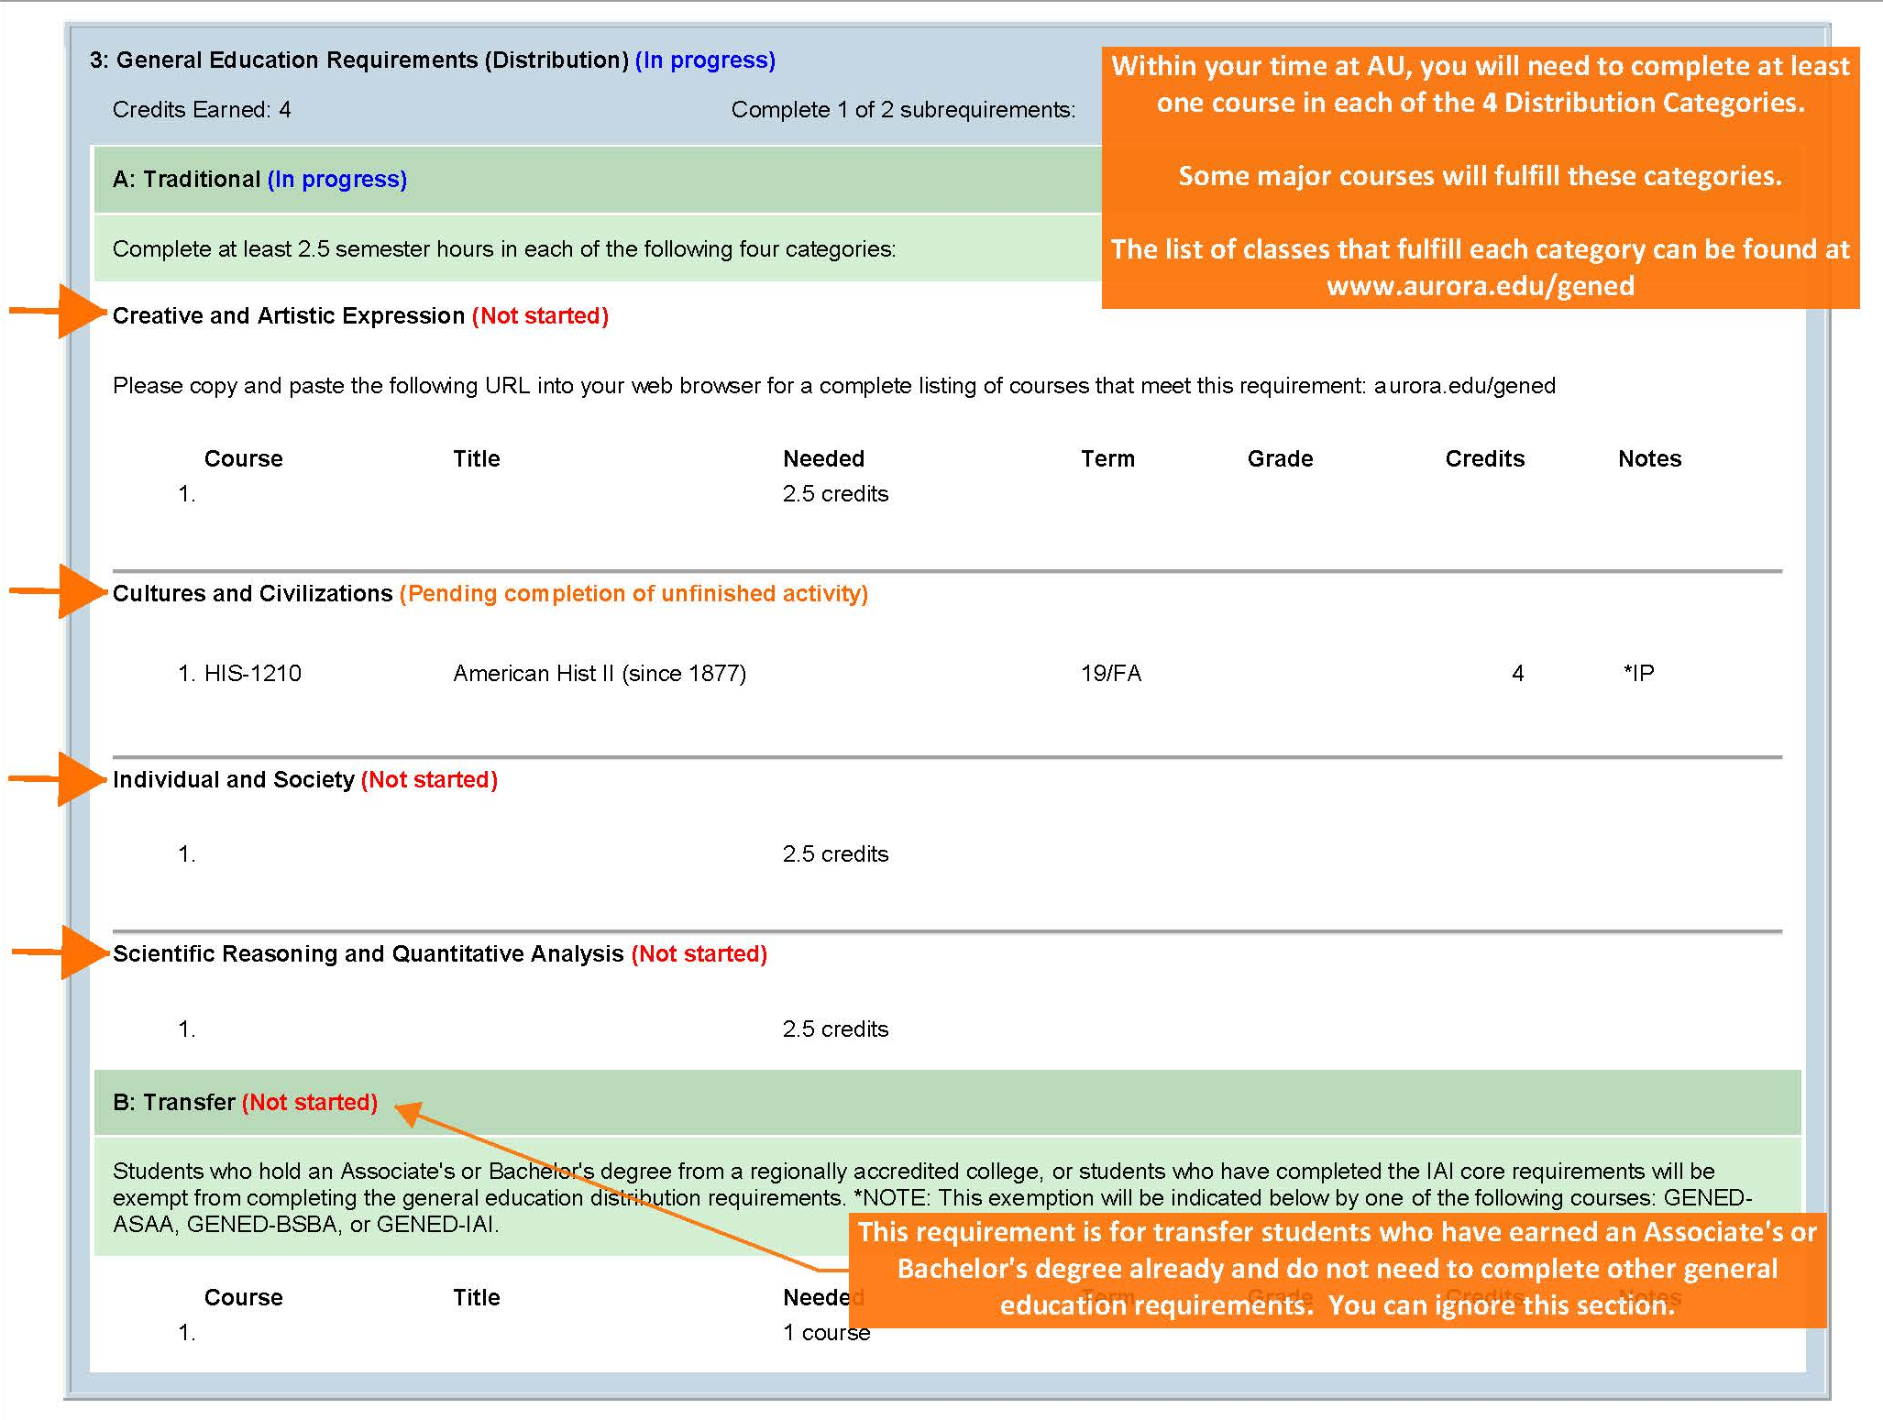

Slide 32
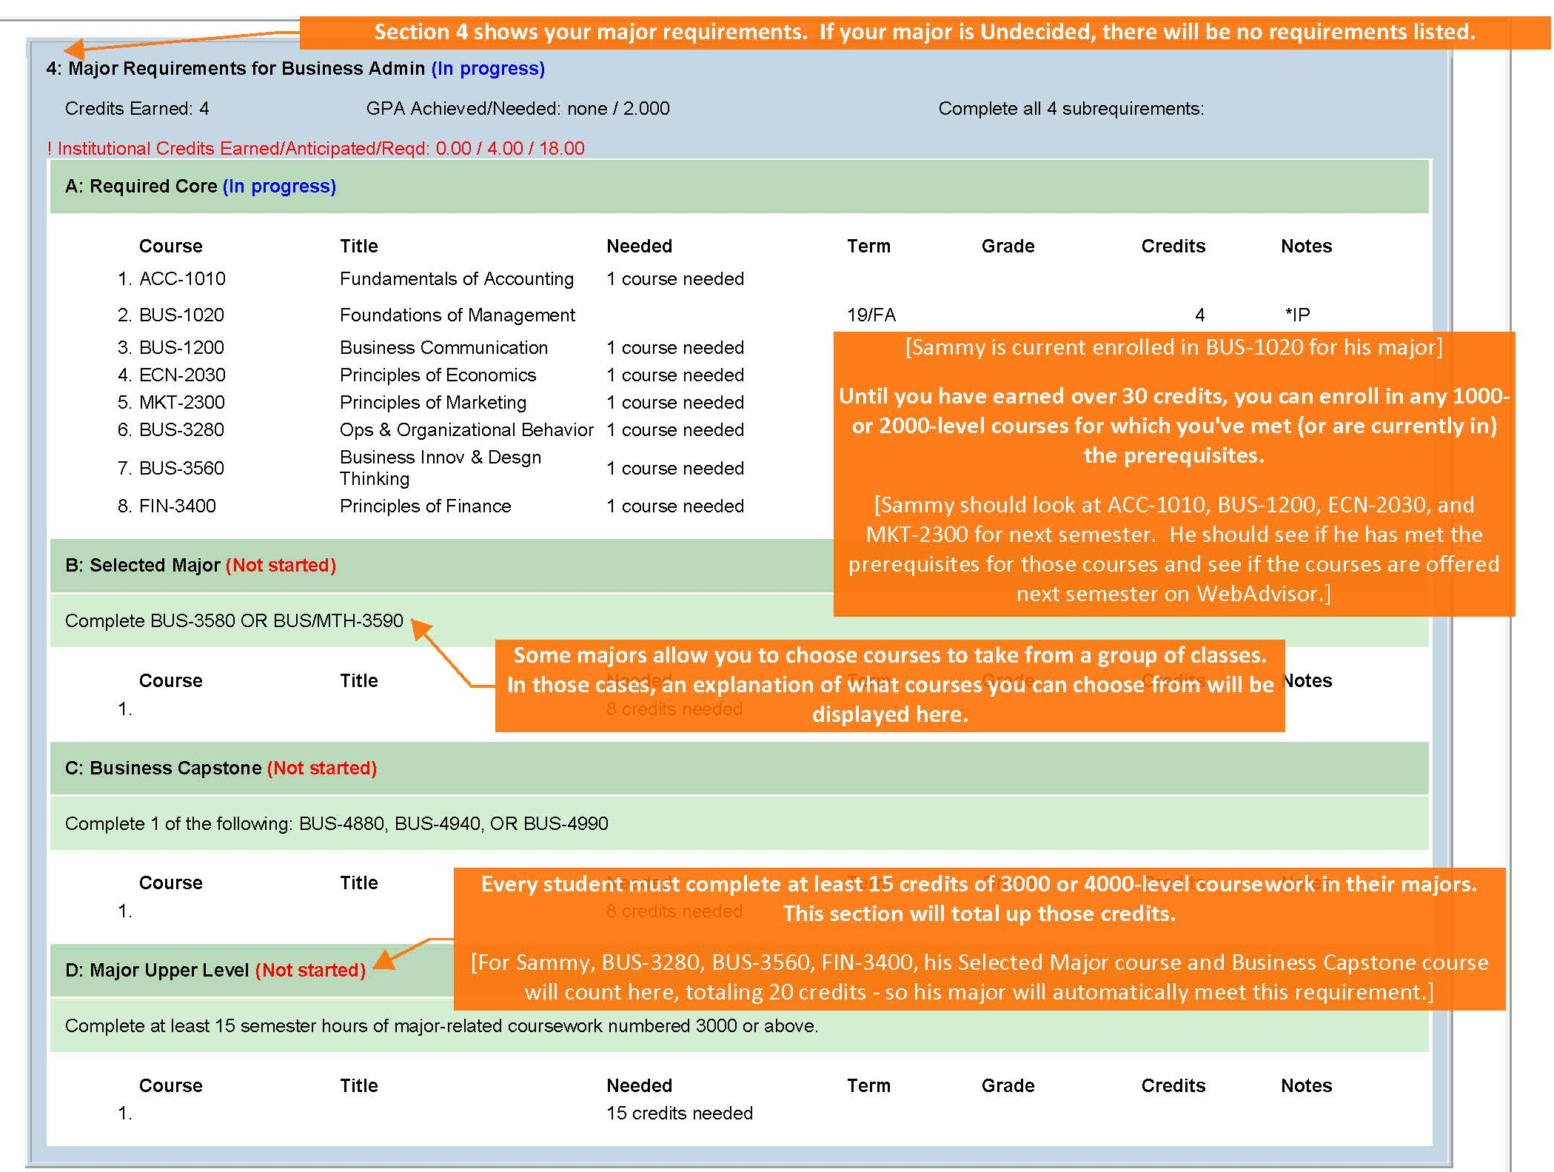

Slide 33
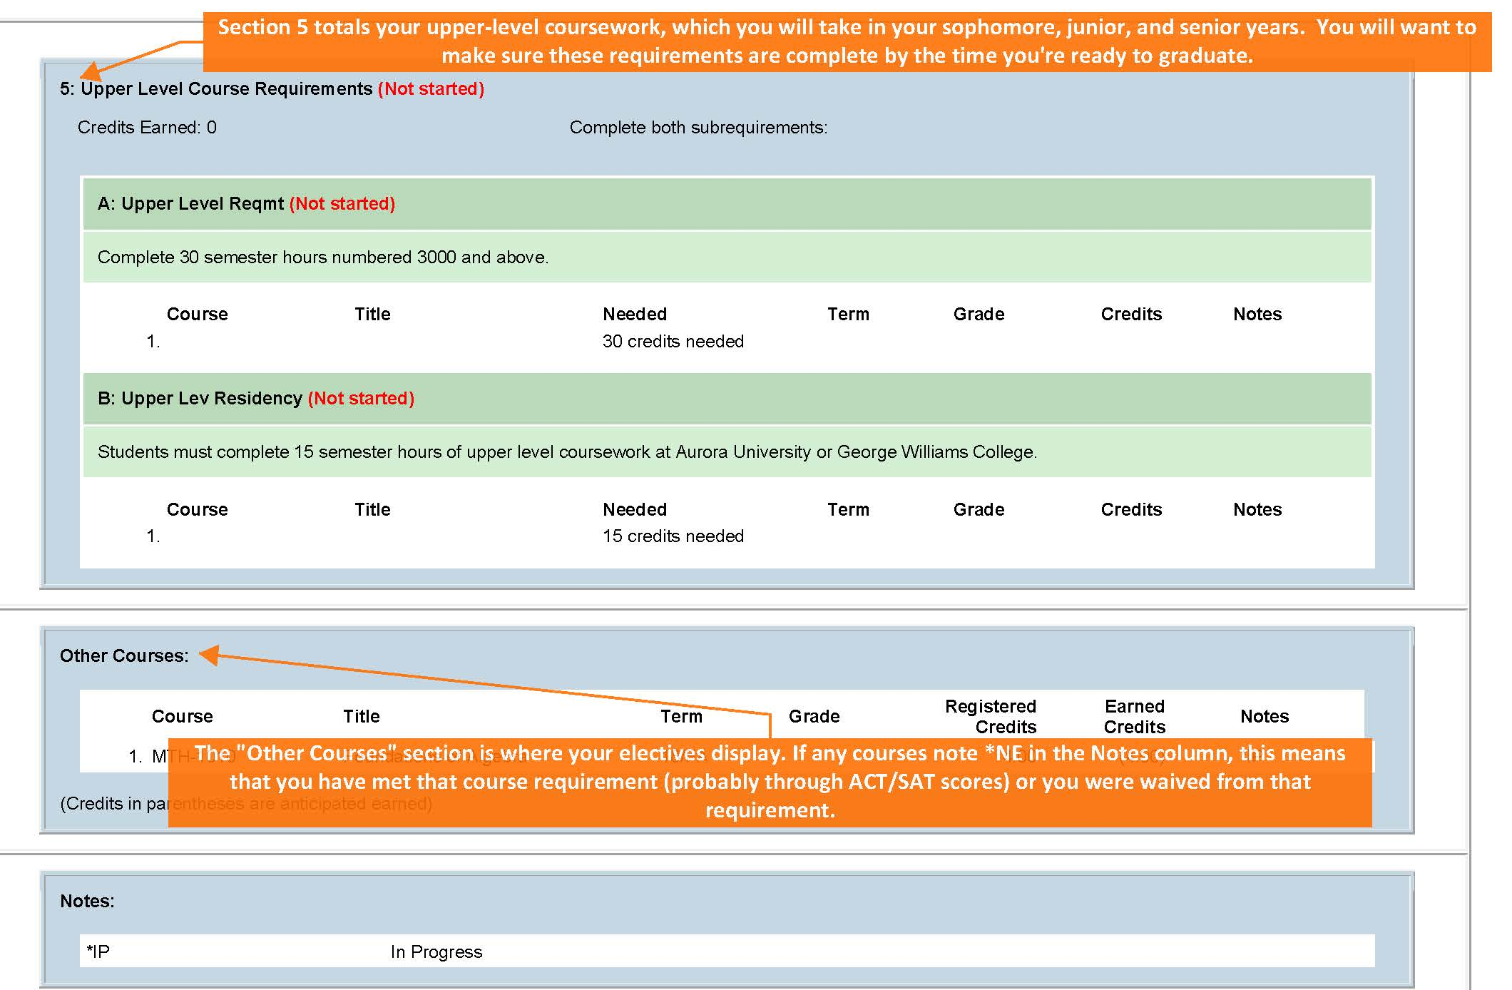

Slide 34
How do I know what classes are available?

Slide 35
After clicking on WebAdvisor from your Okta dashboard click on Search for Course Sections.

Slide 36
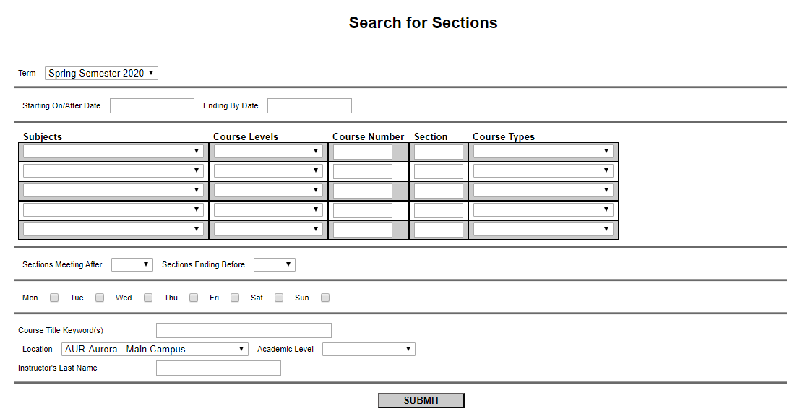
Set the Term as Spring Semester 2020
and the Location as AUR-Aurora-Main Campus.

Slide 37
You can use the Subjects drop-down menus to search for courses by Subject, such as ENG-English (for ENG1000).

Slide 38
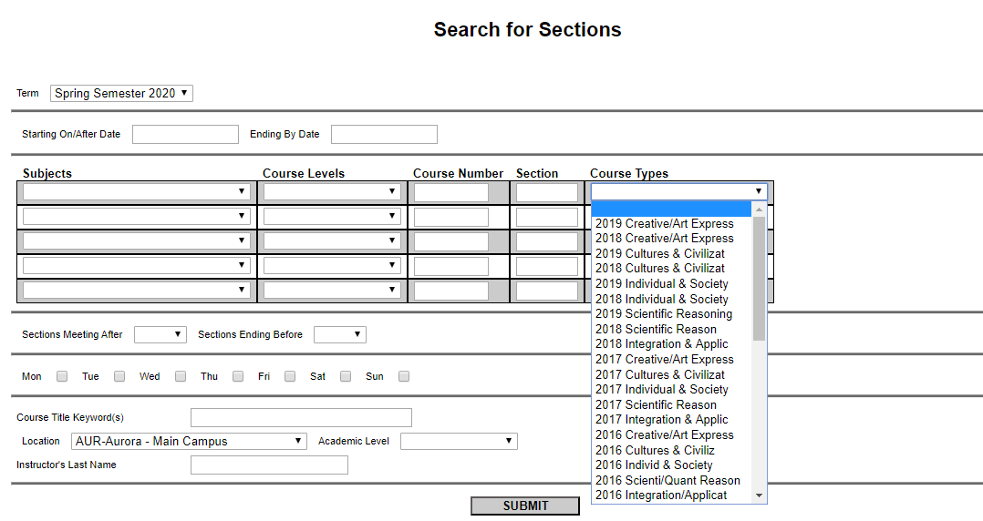
You can use the Course Types drop-down menus to search for courses by Distribution Category.
Be sure to select only 2019 categories.

Slide 39
You can type in Course Numbers if you want.
Example: This search will display all MTH1030 sections, all accounting and communication courses, and all courses that satisfy the Individual & Society distribution category offered in the Spring 2020 semester.

Slide 40
You can limit your search by days/times if you want.
Example: This search will only display courses that meet between 1:00pm and 5:00pm on Monday, Wednesday, and/or Friday on the Aurora campus.

Slide 41
Shows if the course is open, closed, or waitlisted. Try to choose open classes.
Click on a course title for a description of the course.
Shows when/where the class meets. Also includes final exam info.
Shows how many seats are still available/the capacity of the class/and how many students are waiting to get into the course (if waitlisted).
Make sure you’ve met all
pre/co-requisites for a course.

Slide 42
How do I plan my schedule?

Slide 43
How Do I Create a Schedule?
Search for courses
1
Sketch out a plan
2
Make decisions
3
Meet with your student success advisor to discuss
4

Slide 44
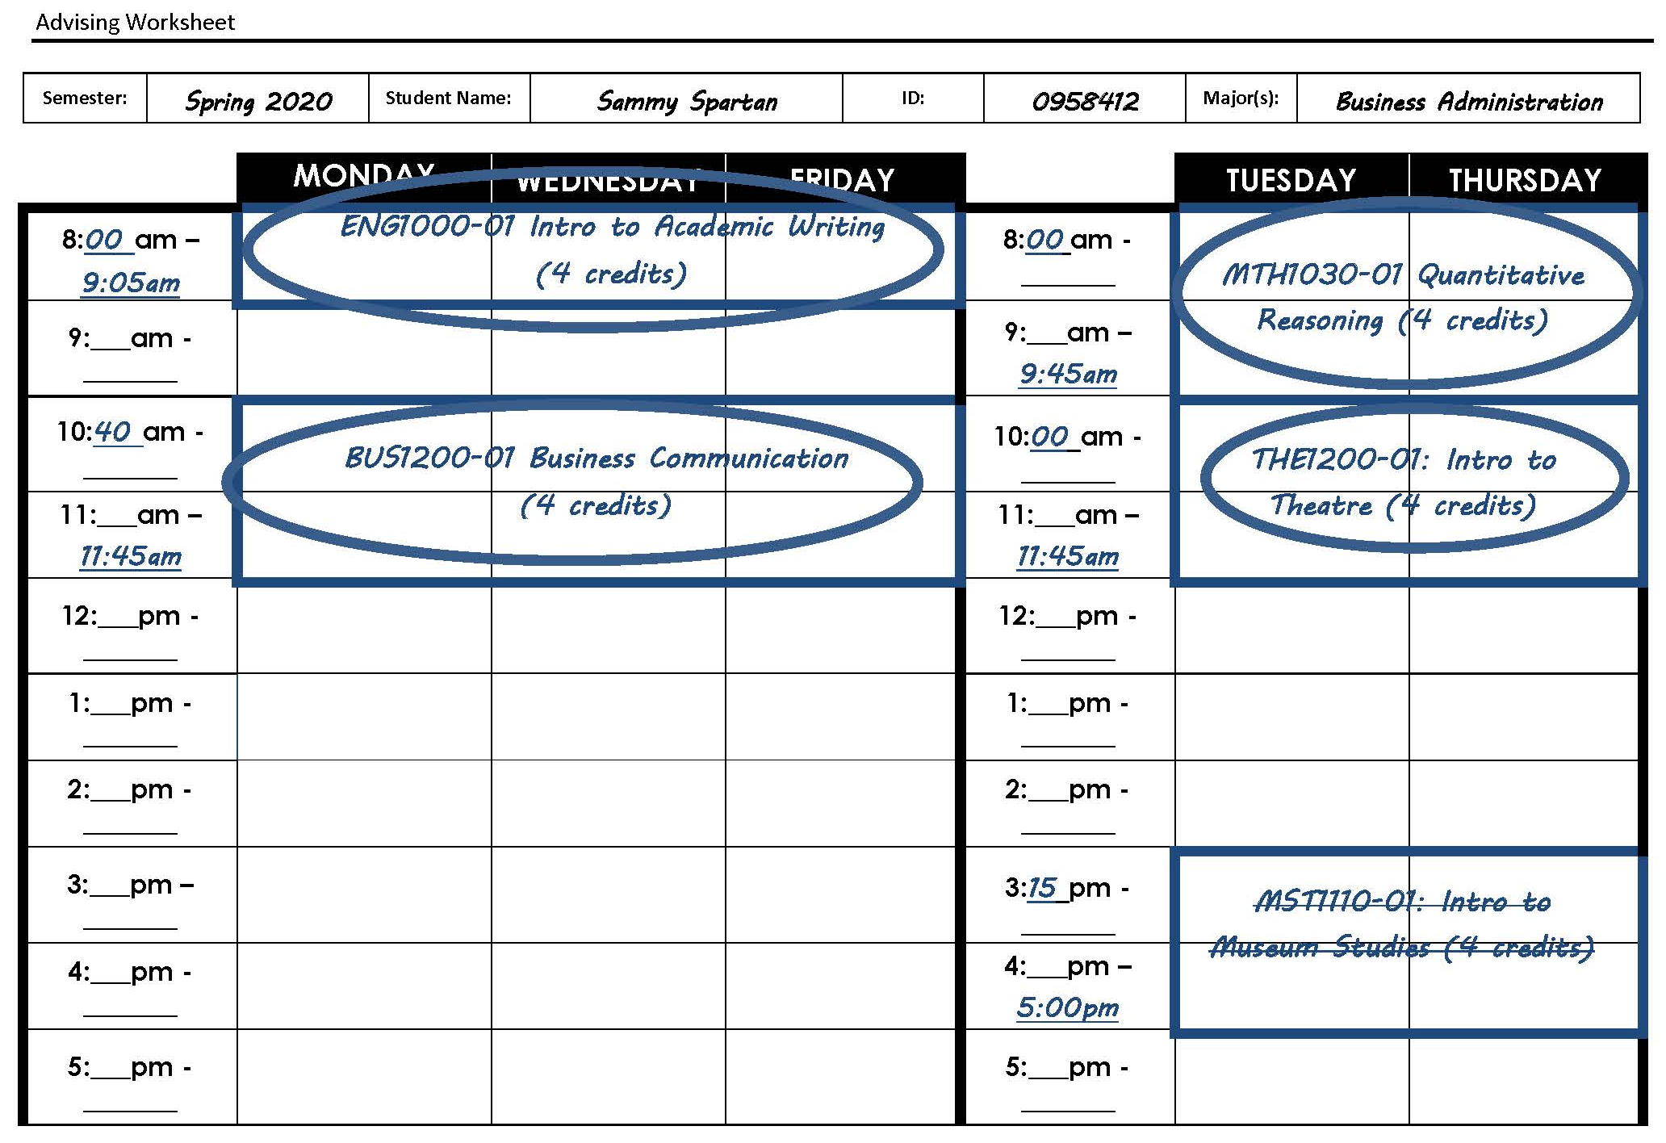
Use an Advising Worksheet to organize class options.

Slide 45
Planning Your Schedule
12-17 credits = full-time status
30 credits = sophomore status
MAP grant requires 15 credits
No one-day per week evening courses
Except labs and physical education activities courses
No online courses without an approved general petition

Slide 46
What Should I Bring to my Advising Appointment?
Course choices
Use the advising worksheet included in your packet
Too many courses are better than too few
Questions!

Slide 47
About Your Appointment
Arrive at least five minutes prior to your appointment to check-in
Remember to bring a form of identification (AU ID, Driver’s License, etc.)
If you need to reschedule your appointment and/or have any questions, please call the Center for Student Success at 630-844-6870 or visit Eckhart 310

Slide 48
What Now?
If you have an ORANGE CARD:
If your label says “SCHEDULE APPOINTMENT FOR HOLD” go to Institute XXX
Visit the Center for Student Success (Eckhart 310) to make an appointment
If you have a GREEN CARD remain seated

Slide 49
Who is (or will be) my advisor?

Slide 50
Accounting: Katie Hardin
Actuarial Science: Kiantra Loza
Biology: Kiantra Loza
Biology/Secondary Education:
Chuck Franco
Business Administration:
Last Names A-L: Katie Hardin
Last Names M-Z:Alissa Struck
Chemistry: Kiantra Loza
Communication: Alissa Struck
Criminal Justice:
Last Names A-L: Barb Calvert
Last Names M-Z: Dain Meza-Gotto
Computer Science: Kiantra Loza
Disabilities Studies: Chuck Franco
Early Childhood Education:
Chuck Franco
Elementary Education: Chuck Franco
Engineering Sciences: Kiantra Loza
English: Tory Nair
English/Secondary Education:
Chuck Franco
Exercise Science: Kerby Mickelson
Finance: Katie Hardin
Graphic Design: Alissa Struck
Human-Animal Studies: Kerby Mickelson
History: Tory Nair
History/Secondary Education:
Chuck Franco
Health Science: Chuck Franco
Marketing: Alissa Struck
Mathematics: Kiantra Loza
Mathematics/Secondary Education:
Chuck Franco
Music: Tory Nair
Musical Theatre: Tory Nair
Nursing
Last Names A-G: Kendra Trudo
Last Names H-R: Deon Robin
Last Names S-Z: Caley Thanepohn
Parks & Recreation Leadership:
Kerby Mickelson
Physical Education: Chuck Franco
Political Science & Public Policy:
Kerby Mickelson
Professional Writing: Alissa Struck
Psychology
Last Names A-L: Barb Calvert
Last Names M-Z: Tory Nair
Social Work:
Last Names A-G: Kendra Trudo
Last Names H-R: Deon Robin
Last Names S-Z: Caley Thanepohn
Sociology: Tory Nair
Software Engineering: Kiantra Loza
Spanish: Tory Nair
Special Education: Chuck Franco
Sport Management: Kerby Mickelson
Theatre: Tory Nair
Therapeutic Recreation: Kerby Mickelson
Undecided: Dain Meza-Gotto

Slide 51
What Now?
If you have a GREEN CARD :
Find your advisor’s table in the foyer
Make an appointment
Get a packet
If you are changing your major, find your NEW advisor

